Slide 1


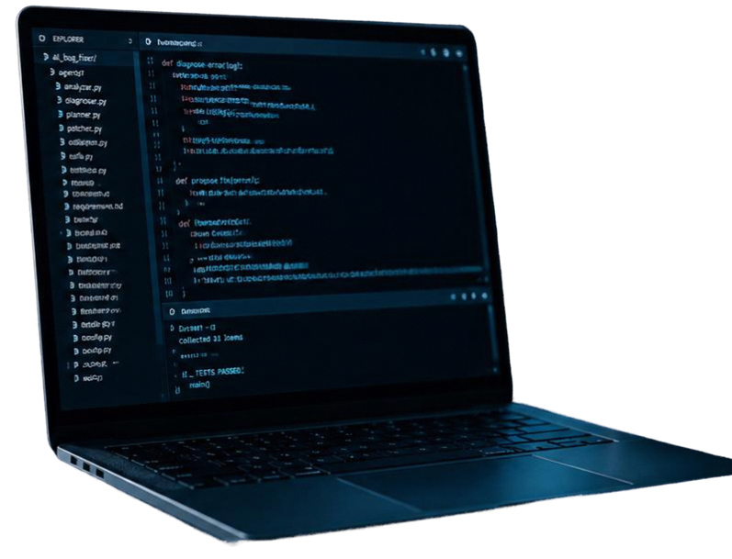
Autonomous AI Bug Fixing Assistant
A Self-Healing Multi-Agent Framework for Automated Defect Diagnosis, Patching, and Validation
Project repository
PriyanshuBaadlas/Autonomous-AI-Bug-Fixer
Tech stack
Python, Groq LLM API, Pytest, Subprocess Sandbox

Slide 2



THE PROBLEM
Developers spend over 40% of engineering time locating and resolving defects.
Manual debugging is a major bottleneck slowing release velocity.
Current AI copilots only suggest code snippets without execution or validation.
Need for a closed-loop system that autonomously diagnoses, fixes, tests, and documents defects.

Slide 3

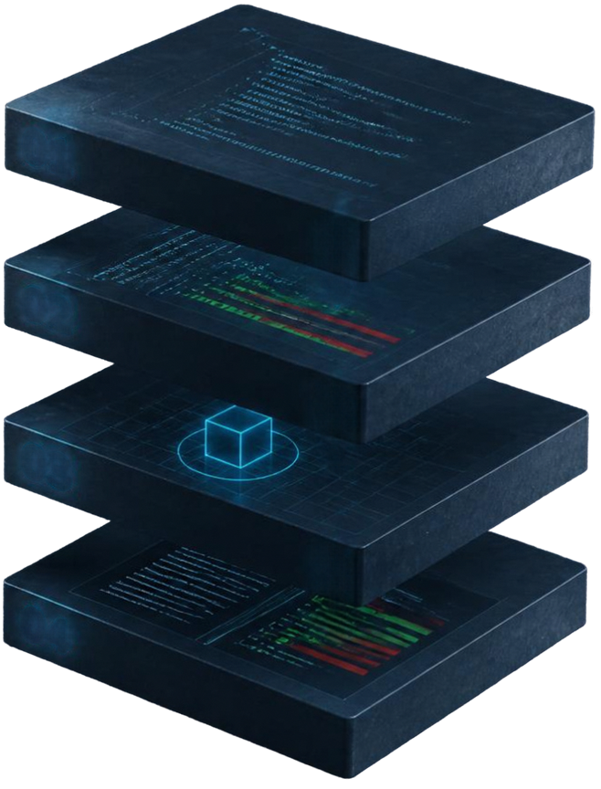



SYSTEM OVERVIEW
Specialized agents dividing software engineering responsibilities
01
02
01
Inspector Agent
Root cause analysis from bug descriptions and stack traces.
03
02
Developer Agent
Generates precise, hallucination-free code patches.
03
Validator Agent
Runs patches in sandboxed environment with Pytest regression suites.
04
04
Reporter Agent
Produces git diffs and Pull Request summaries for deployment.

Slide 4








THE SOLUTION
Technical Architecture & Core Components
01
02
03
04
Host Environment
Inference Engine
Patching Engine
Validation Engine
Antigravity IDE /CLI Controller (main.py)
Groq API for high-speed LLM reasoning
Block-level targeted code replacement avoiding whole-file rewrites
Isolated temporary workspace with custom PYTHONPATH and sandboxed subprocesses

Slide 5










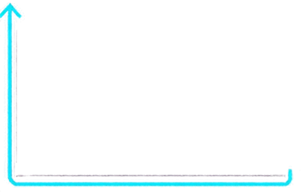
Agent Workflow & The Self-Healing Feedback Loop
1
2
3
4
Tests Pass
Ingest
Code & Logs
Inspector
(RCA)
Developer
(Draft Patch)
Validator
(Pytest Sandbox)
Automated commit and PR summary generated
Tests Fail
Error tracebacks returned to Developer Agent
Up to 3 auto-retries

Slide 6
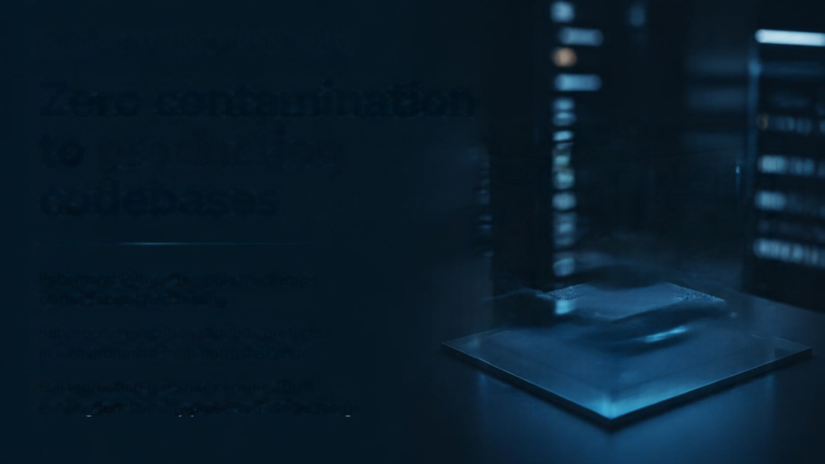

SANDBOX ISOLATION & REGRESSION SAFETY
Zero contamination to production codebases
Ephemeral Python tempfile mkdtemp clones for isolated testing
Subprocess execution sandbox protects live environment from untrusted code
Full regression test suites ensure 100% existing functionality preserved before merge

Slide 7










PROTOTYPE VALIDATION & LIVE DEMONSTRATION
Autonomous resolution of logic defects in
under 15 seconds
Ingests targeted logic failure example like calculator.py assertion error
Instant root cause analysis pinpointing offending lines
Automated unified diff patch generated with first-pass test success
Entire debugging lifecycle without human intervention

Slide 8

Business Impact, Scalability & Roadmap
BUSINESS IMPACT
60%+
60%+
Significant cost savings by freeing senior engineers from triage
reduction in Mean Time to Resolution (MTTR)
ROADMAP
CI/CD GitHub Action integration for autonomous PR reviews
Support for TypeScript, Go, Java languages and docker containerized sandboxing

